Slide 1
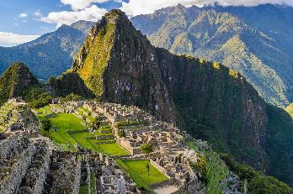
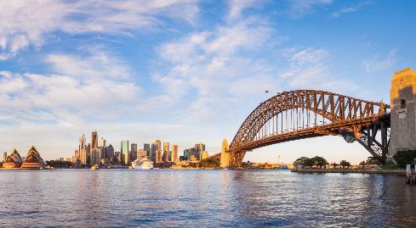
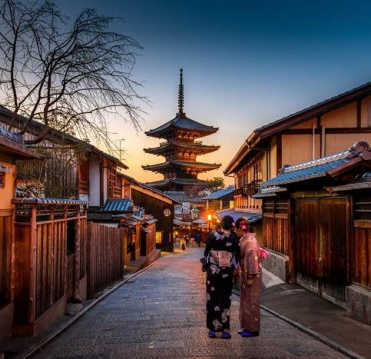
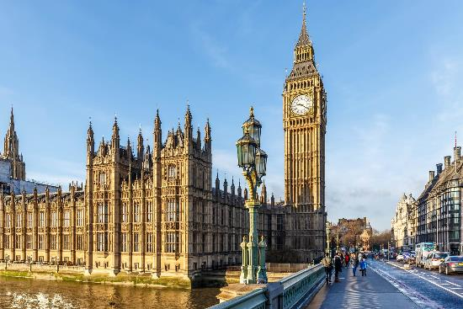
Pack your bags!
We’re going to…

Slide 2
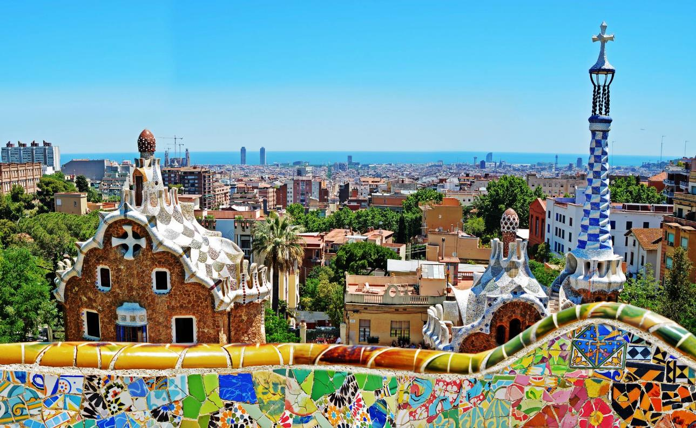
Let’s go to…
Spain
✈
Barcelona & Madrid – 8 Days
Notes:
Welcome/ Thanks for coming to learn about this exciting opportunity for your child to travel abroad on an educational tour ____________ during _____________

Slide 4
Notes:
Spain

Slide 5
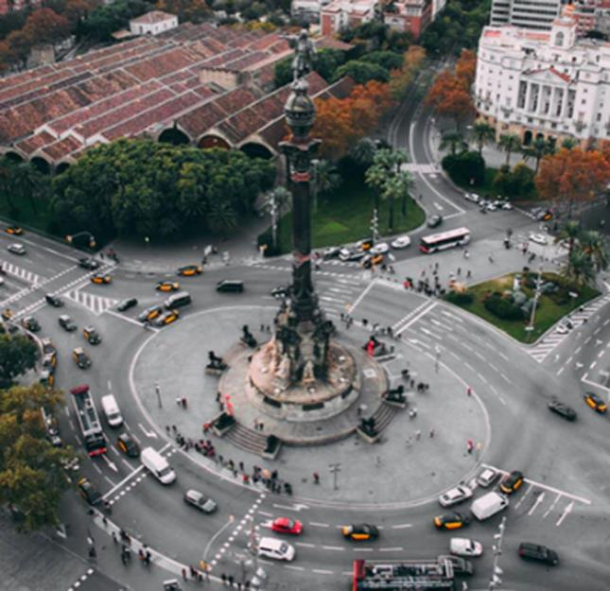
Admire Barcelona’s architecture
Notes:
Barcelona, Spain

Slide 6
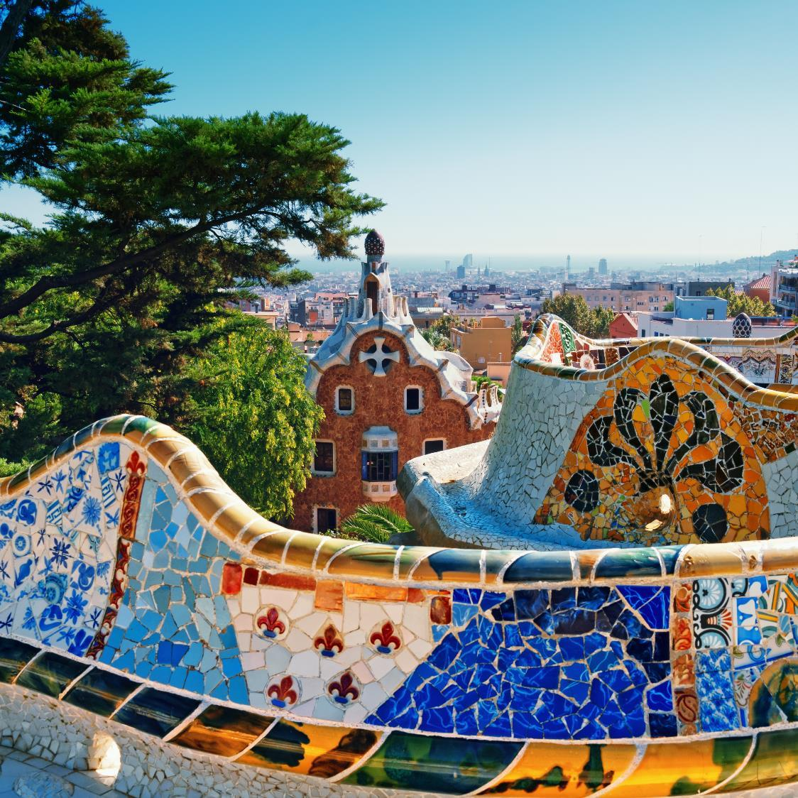
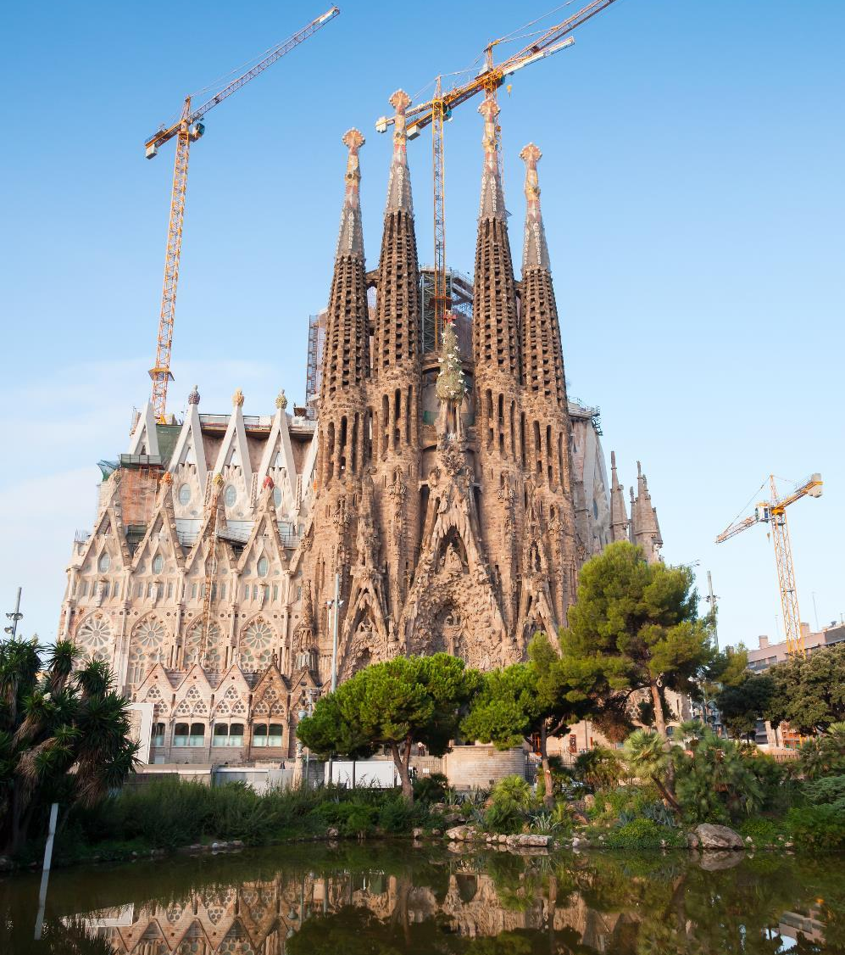
Spain
Which location is a cooler photo stop?
(Barcelona)
La Sagrada Família
Park Güell

Slide 8
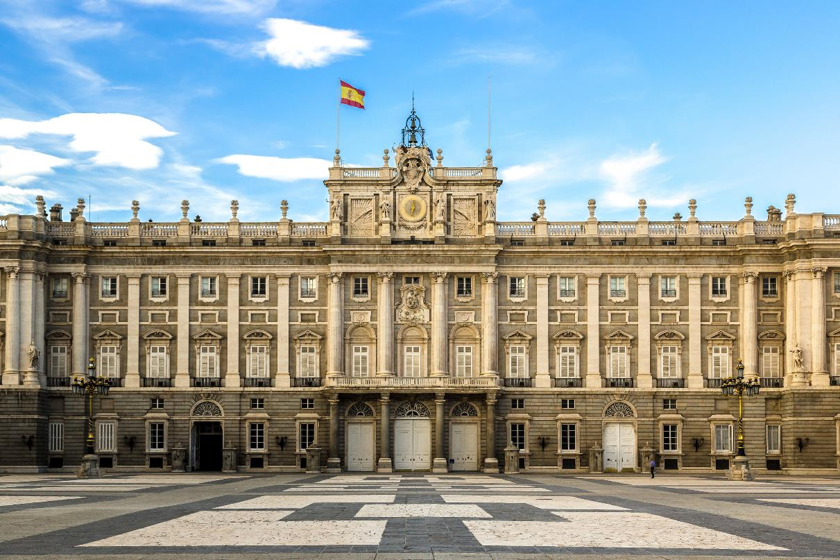
Visit the Royal Palace in Madrid

Slide 9
Notes:
Spain

Slide 10
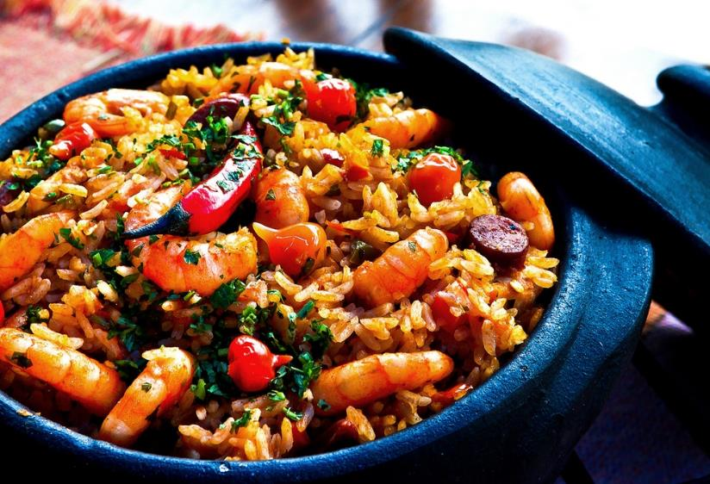
All about the paella
Notes:
Spain

Slide 11
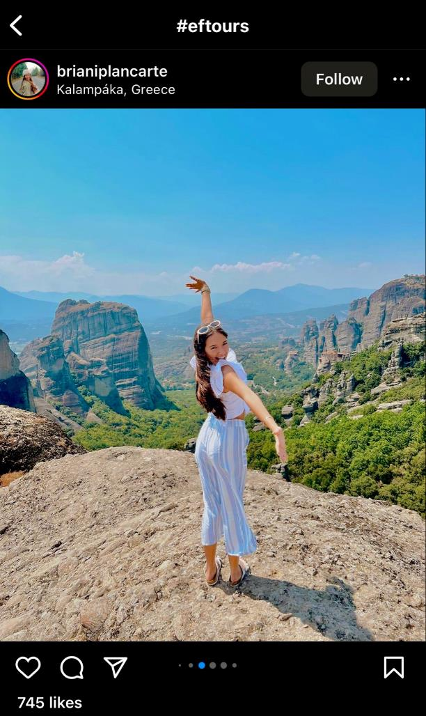
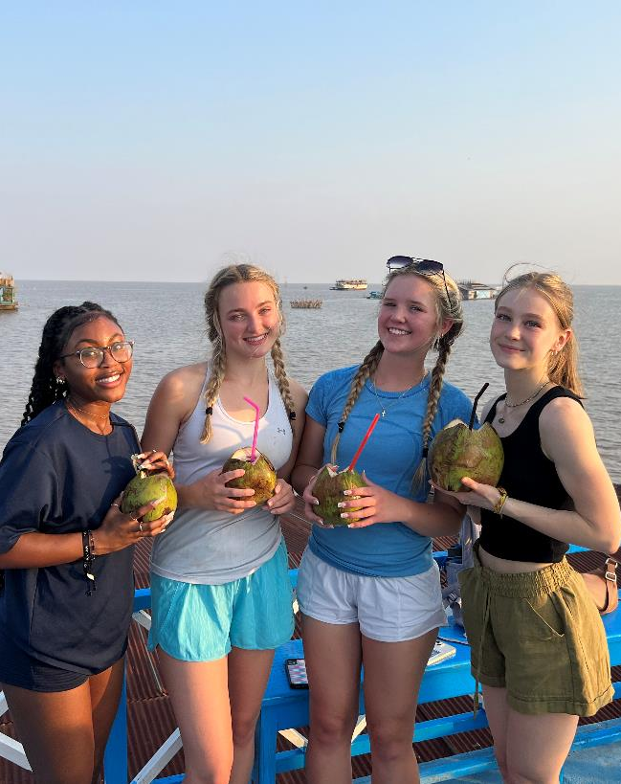
picsontour
This could be YOU!
Notes:
SPEAKER:
Travel is important now more than ever and I really want all of you to have this experience of a lifetime
GOAL:
Show students and families your passion for travel– the amazing things you’ve seen and the transformation that’s happened along the way OR your excitement about having new experiences with the group!

Slide 12
09/20/2023
6pm
Pope Learning Commons - Media Center

